Slide 1

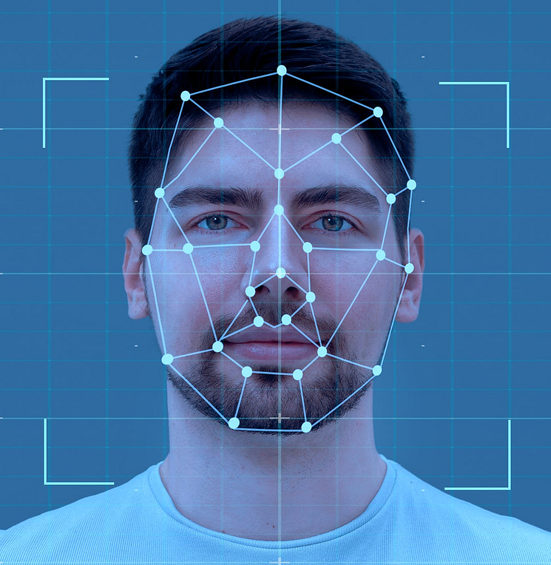









Face and eye detection – Haar Cascades
Summary
Unconsciousness detection
Application of artificial intelligence in image recognition and classification
Lead teacher
Gonçalo Nobre
Teaching assistant
Karollyne Silva
João Lopes
Data Analytics
Ironhack Bootcamp
Object detection algorithm, used in OpenCV, an open computer vision library
Capable of detecting objects in images, regardless of their location and scale
Not as accurate as other modern algorithms, tend to be prone to false-positive detections
Really fast, making it possible to detect objects in real-time video streams
Unconsciousness detection
Application of artificial intelligence in image recognition and classification
Conclusions
Applications
Results
Methodology
Introduction
Presentation
Student
Project
Supervisors
4
3
Unconsciousness detection
2
Unconsciousness detection
Unconsciousness detection
March 2024

Slide 2
Face and eye detection – Haar Cascades
Summary
Unconsciousness detection
Application of artificial intelligence in image recognition and classification
Lead teacher
Gonçalo Nobre
Teaching assistant
Karollyne Silva
João Lopes
Data Analytics
Ironhack Bootcamp
Object detection algorithm, used in OpenCV, an open computer vision library
Capable of detecting objects in images, regardless of their location and scale
Not as accurate as other modern algorithms, tend to be prone to false-positive detections
Really fast, making it possible to detect objects in real-time video streams
Unconsciousness detection
Application of artificial intelligence in image recognition and classification
Conclusions
Applications
Results
Methodology
Introduction
Presentation
Student
Project
Supervisors
4
Unconsciousness detection
3
2
Unconsciousness detection
Unconsciousness detection
March 2024

Slide 3



Face and eye detection – Haar Cascades
Summary
Unconsciousness detection
Application of artificial intelligence in image recognition and classification
Lead teacher
Gonçalo Nobre
Teaching assistant
Karollyne Silva
João Lopes
Data Analytics
Ironhack Bootcamp
Face and eye detection in video by applying an image recognition algorithm to each of its frames in real time
Object detection algorithm, used in OpenCV, an open computer vision library
Capable of detecting objects in images, regardless of their location and scale
Not as accurate as other modern algorithms, tend to be prone to false-positive detections
Really fast, making it possible to detect objects in real-time video streams
Unconsciousness detection
Application of artificial intelligence in image recognition and classification
Eye classification to predict whether the eyes are open or closed, and then conclude about the person’s unconsciousness
Conclusions
Applications
Results
Methodology
Introduction
Presentation
Conscious status is deteriminated by open eyes and unconscious status is determinated by a consistente period of closed eyes
Student
Project
Supervisors
Identification and visualization of some applications in everyday situations, aiming to determine the usefulness of the tools
4
3
Unconsciousness detection
Unconsciousness detection
2
Unconsciousness detection
March 2024

Slide 4
Face and eye detection – Haar Cascades
Summary
Unconsciousness detection
Application of artificial intelligence in image recognition and classification
Lead teacher
Gonçalo Nobre
Teaching assistant
Karollyne Silva
João Lopes
Data Analytics
Ironhack Bootcamp
Face and eye detection in video by applying an image recognition algorithm to each of its frames in real time
Object detection algorithm, used in OpenCV, an open computer vision library
Capable of detecting objects in images, regardless of their location and scale
Not as accurate as other modern algorithms, tend to be prone to false-positive detections
Really fast, making it possible to detect objects in real-time video streams
Unconsciousness detection
Application of artificial intelligence in image recognition and classification
Eye classification to predict whether the eyes are open or closed, and then conclude about the person’s unconsciousness
Conclusions
Applications
Results
Methodology
Introduction
Presentation
Conscious status is deteriminated by open eyes and unconscious status is determinated by a consistente period of closed eyes
Student
Project
Supervisors
Identification and visualization of some applications in everyday situations, aiming to determine the usefulness of the tools
4
3
Unconsciousness detection
2
Unconsciousness detection
Unconsciousness detection
March 2024

Slide 5

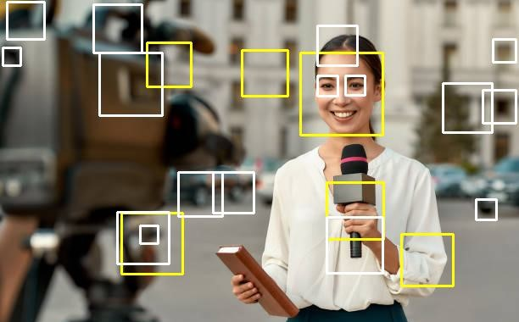
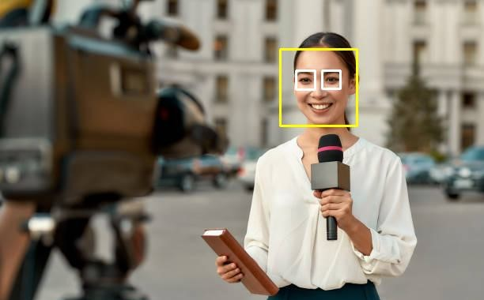
Face and eye detection – Algorithm improvement
Eye
Face
Conclusions
Applications
Results
Methodology
Introduction
Presentation
Facial symmetries and proportions
5
Unconsciousness detection

Slide 6
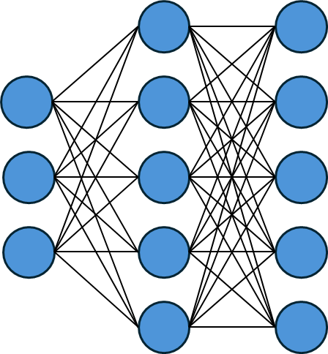
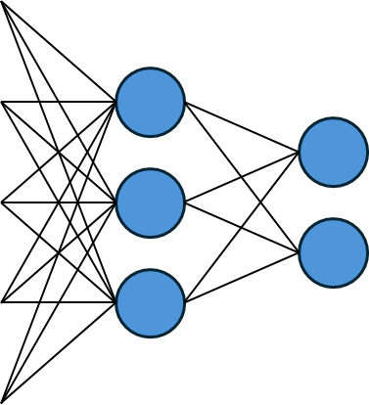


Eye classification – Transfer learning
Deep learning architecture: MobileNet
Pretrained layers
Conclusions
Applications
Results
Methodology
Introduction
Presentation
Output
layer
Input
layer
6
Unconsciousness detection

Slide 7
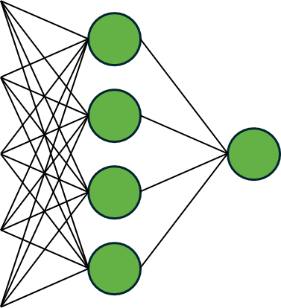

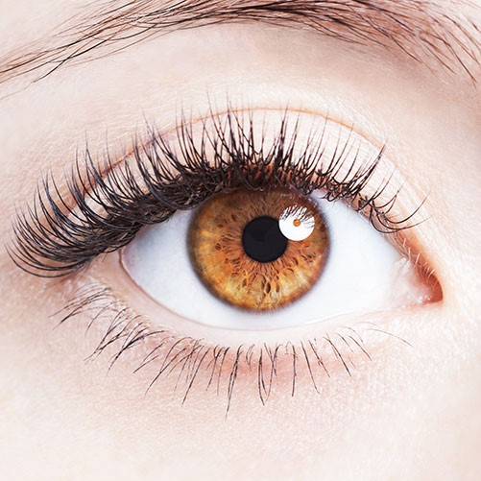

Eye classification – Transfer learning
Pretrained layers
New layers
Conclusions
Applications
Results
Methodology
Introduction
1
0
Presentation
Output
layer
Input
layer
6
Unconsciousness detection

Slide 8

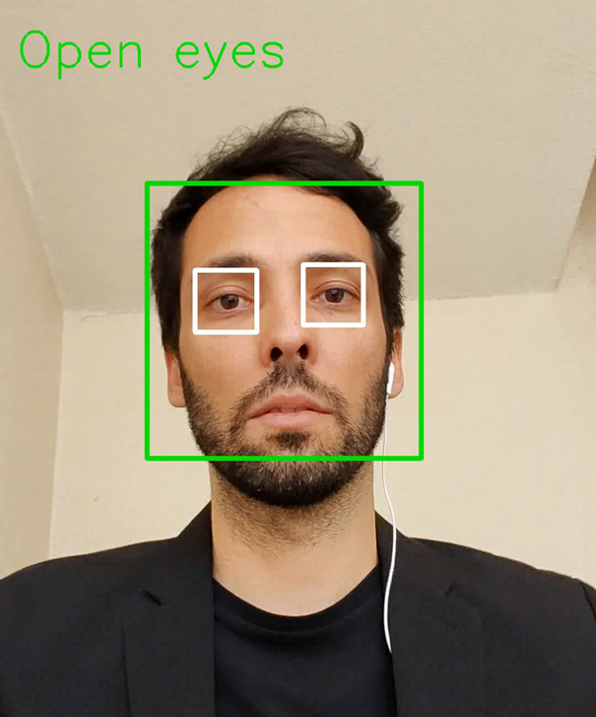
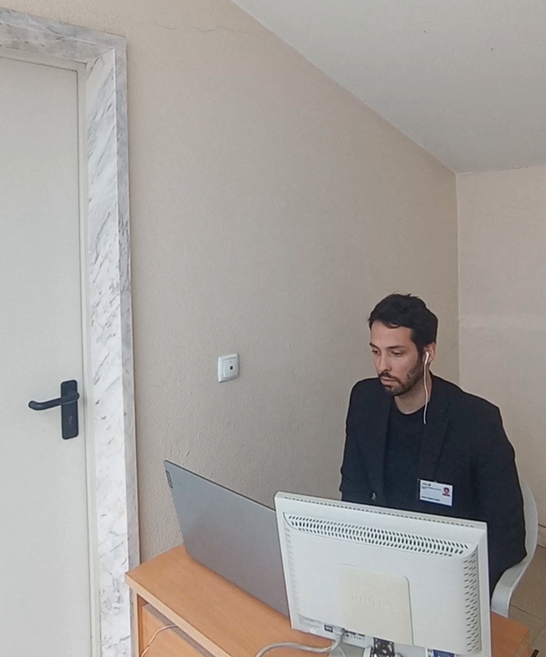
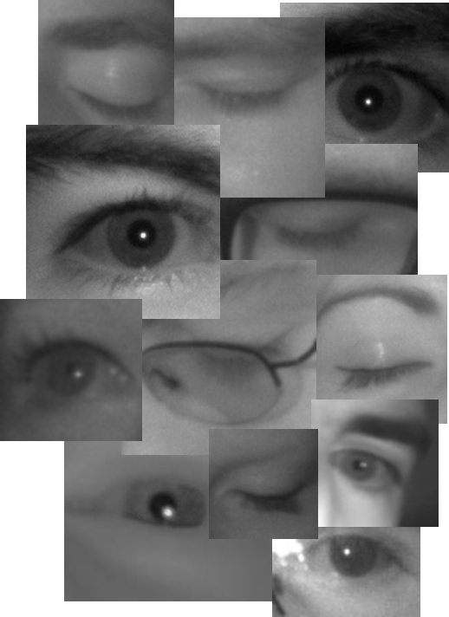
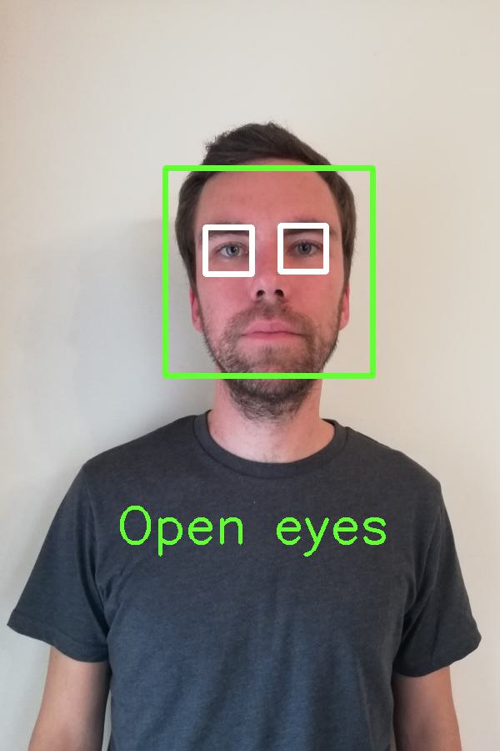
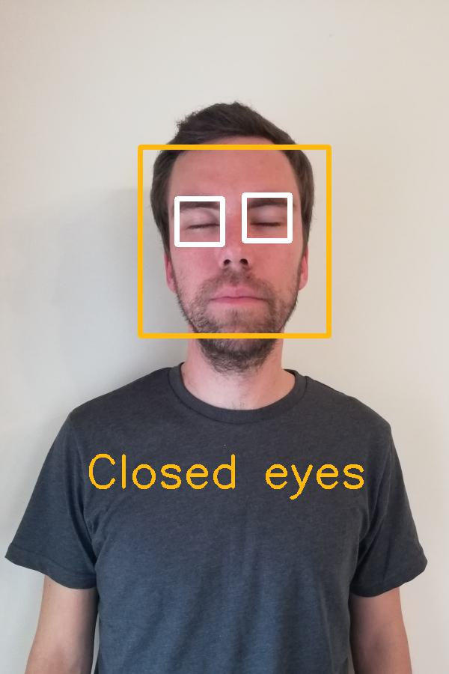
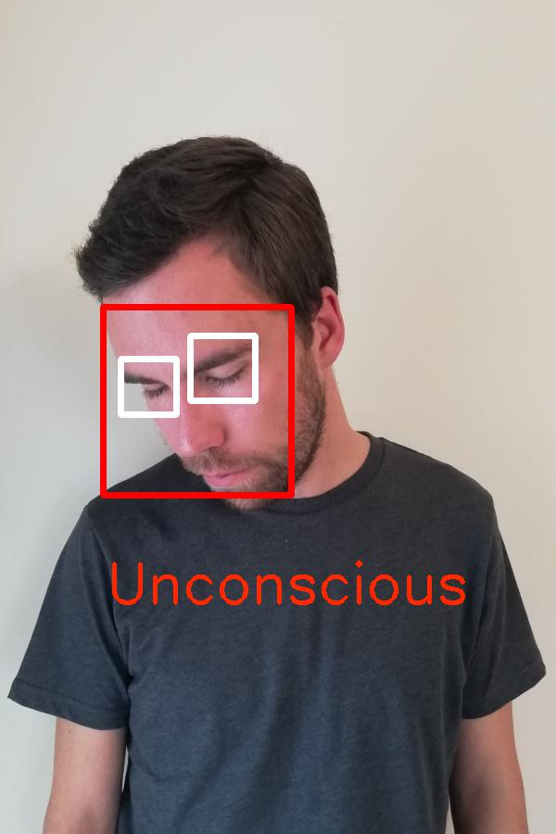







Alarm sounds when security guard falls asleep
Live demonstration
Eye classification – Model training
79 660 pictures (MRL Eye Dataset)
Different dimensions
50 / 50 % balanced data
Sample of 37 people
Diversity in gender and race
Use of glasses and makeup
Conclusions
Applications
Results
Methodology
Introduction
Presentation
80 / 20 % train test validation split
98 % of accuracy
9
Unconsciousness detection
8
7
Unconsciousness detection
Unconsciousness detection

Slide 9
Alarm sounds when security guard falls asleep
Live demonstration
Eye classification – Model training
79 660 pictures (MRL Eye Dataset)
Different dimensions
50 / 50 % balanced data
Sample of 37 people
Diversity in gender and race
Use of glasses and makeup
Conclusions
Applications
Results
Methodology
Introduction
Presentation
80 / 20 % train test validation split
98 % of accuracy
9
8
Unconsciousness detection
Unconsciousness detection
7
Unconsciousness detection

Slide 10
Alarm sounds when security guard falls asleep
Live demonstration
Eye classification – Model training
79 660 pictures (MRL Eye Dataset)
Different dimensions
50 / 50 % balanced data
Sample of 37 people
Diversity in gender and race
Use of glasses and makeup
Conclusions
Applications
Results
Methodology
Introduction
Presentation
80 / 20 % train test validation split
98 % of accuracy
9
8
Unconsciousness detection
7
Unconsciousness detection
Unconsciousness detection

Slide 11


Alarm sounds when security guard falls asleep
Conclusions
Applications
Results
Methodology
Introduction
Presentation
9
Unconsciousness detection

Slide 12
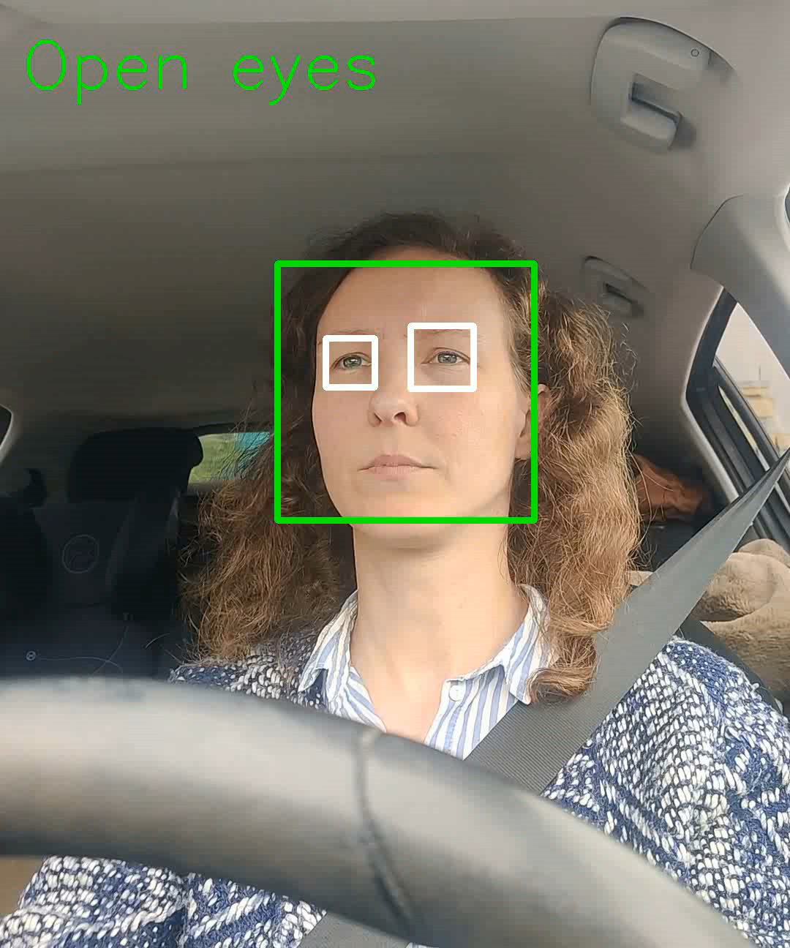
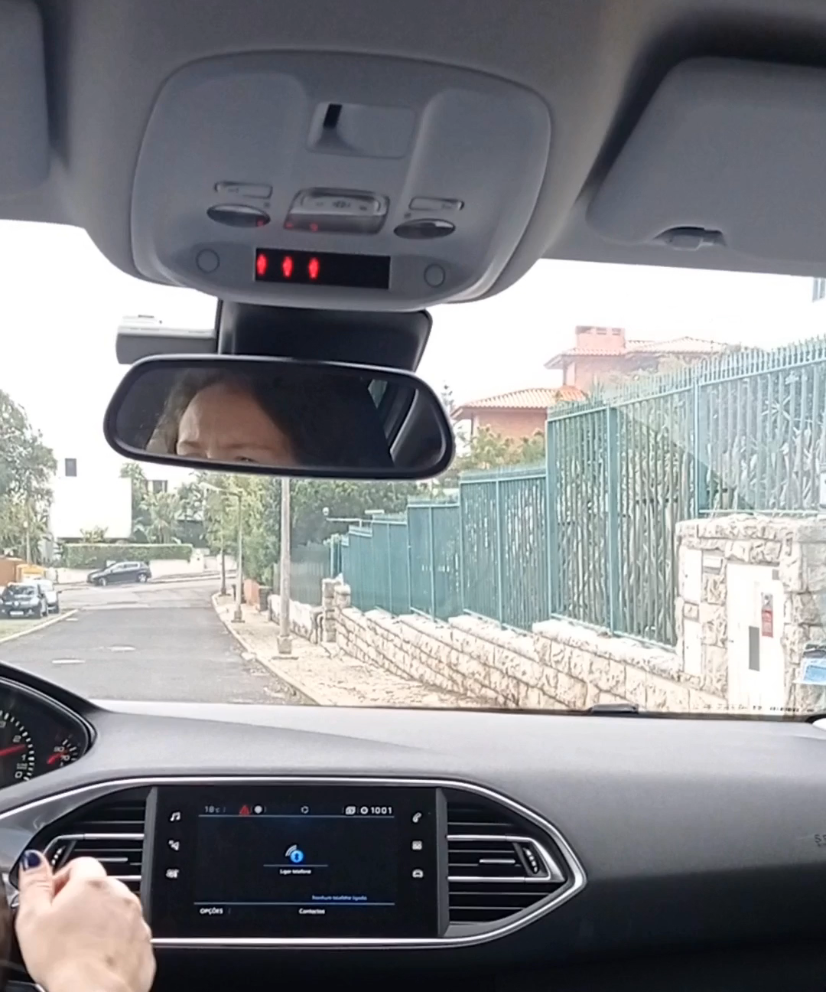
Synthesis
Vehicle stops when driver passes out
Conclusions
Applications
Results
Methodology
Introduction
Presentation
11
10
Unconsciousness detection
Unconsciousness detection

Slide 13
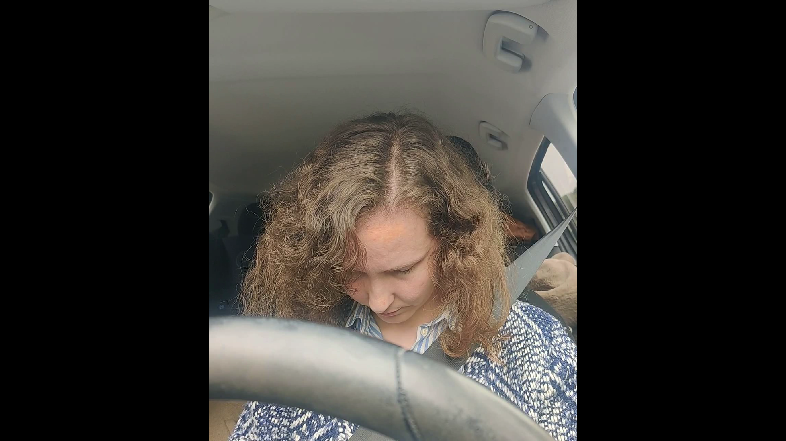
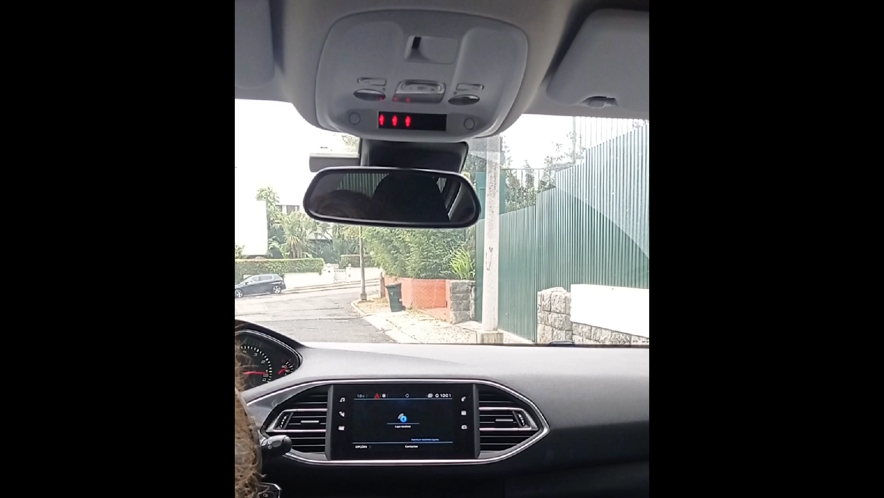
Synthesis
Vehicle stops when driver passes out
Unconsciousness detection
Application of artificial intelligence in image recognition and classification
Conclusions
Applications
Results
Methodology
Introduction
Presentation
11
10
Unconsciousness detection
Unconsciousness detection

Slide 14
Synthesis
Vehicle stops when driver passes out
Although Haar Cascades is not the most accurate object detection algorithm, it’s really fast, making it possible to apply it to real-time video streams
The implementation of relevant changes related to facial symmetry and proportions allowed the improvement of the face and eye detection algorithm
Unconsciousness detection
Application of artificial intelligence in image recognition and classification
Thank you!
With the transfer learning technique it was possible to use existing knowledge to boost the performance of a new model used on a related task
Conclusions
Applications
Results
Methodology
Introduction
Presentation
The eye classification model was trained using a very diverse and complete database, which made it more robust and allowed it to achieve an accuracy of 98%
The biggest challenges faced are related to the quality of the captured image and to the difficulty of producing fast and accurate results at the same time
The work developed was successfully applied in some real-life examples and, from one of them, an app was created
11
Unconsciousness detection
10
Unconsciousness detection
March 2024

Slide 15
Synthesis
Movie pauses when viewer falls asleep – Pause4Sleep.com
Although Haar Cascades is not the most accurate object detection algorithm, it’s really fast, making it possible to apply it to real-time video streams
The implementation of relevant changes related to facial symmetry and proportions allowed the improvement of the face and eye detection algorithm
Unconsciousness detection
Application of artificial intelligence in image recognition and classification
Thank you!
With the transfer learning technique it was possible to use existing knowledge to boost the performance of a new model used on a related task
Conclusions
Applications
Results
Methodology
Introduction
Presentation
The eye classification model was trained using a very diverse and complete database, which made it more robust and allowed it to achieve an accuracy of 98%
The biggest challenges faced are related to the quality of the captured image and to the difficulty of producing fast and accurate results at the same time
The work developed was successfully applied in some real-life examples and, from one of them, an app was created
11
Unconsciousness detection
10
Unconsciousness detection
March 2024

